Slide 1

Electronics 101
Basics of electricity

Slide 2
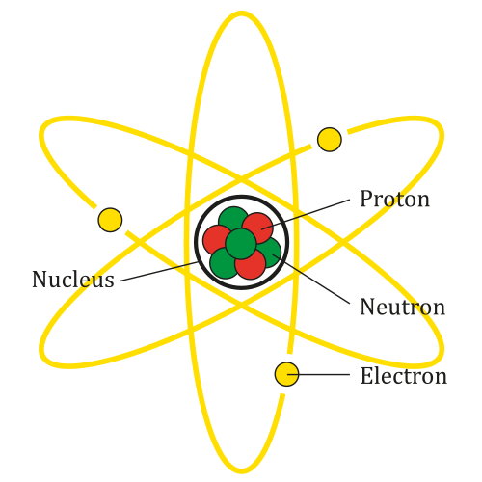
Everything is made up of atoms
Without atoms we would not exist
What makes up atoms
Protons (+)
Electrons (-)
Neutrons

Slide 3
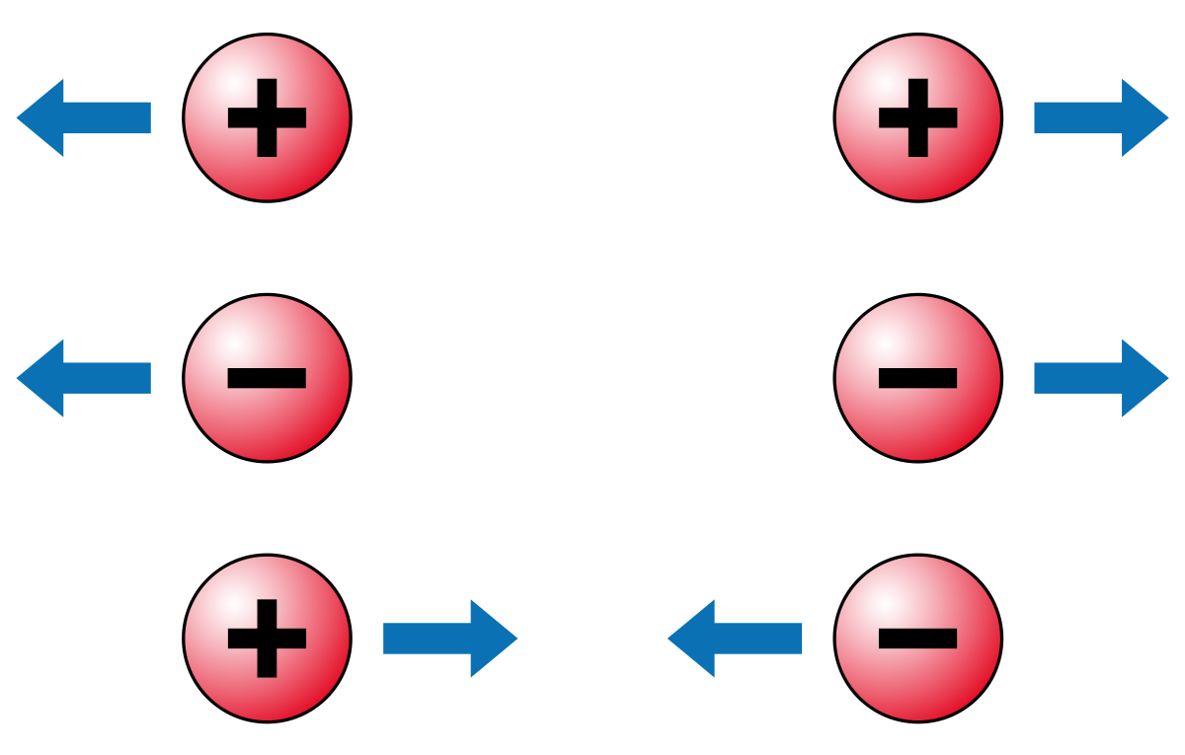
What does that have to do with Electricity
We tend to use and abuse atoms
Charge attraction

Slide 4
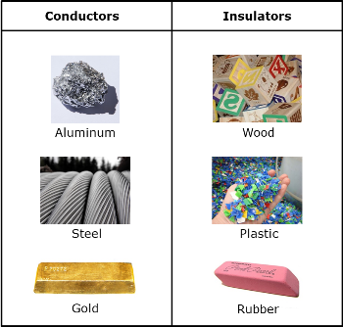
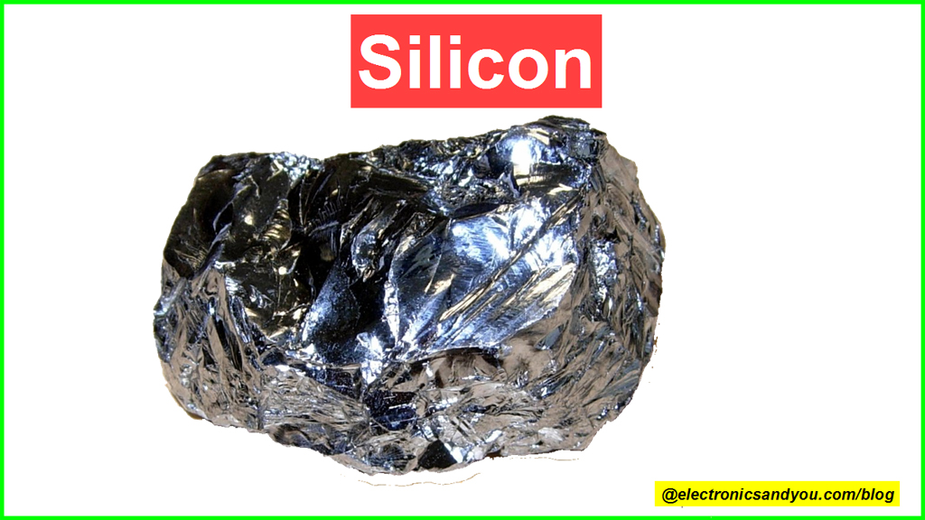
Types of materials
Conductor
Insulator
Semiconductor

